Slide 1

ILP 2020 – W6S3 Final exam practice and end
Matthieu DE MARI – Singapore University of Technology and Design

Slide 2
Useful links
ISTD catalogue
https://istd.sutd.edu.sg/education/undergraduate/course-catalogue/
DAI catalogue
https://dai.sutd.edu.sg/education/undergraduate/courses/

Slide 3
Advanced Python
More advanced concepts in Python
Object-oriented programming
Visualization with Matplotlib (as displaying board in tic tac toe, but also visualizing functional graphs, etc.)
User interfaces (graphical buttons and other things to ease the user interaction with your programs)
Advanced algorithmics (how to decide and measure the quality of a function design)
Etc.

Slide 4
Advanced Computer science
Computational structures: understand the basic structure of computer and the behaviour of its components (CPU, memory, etc.)
Software engineering: how to organize large scale projects and manage teams working in computer science projects.
Networks and security: how is information exchanged over networks such as the internet, and how to protect systems from unwanted attacks.

Slide 5
Web design and software design
Langagues for web programming and designing websites
(HTML, CSS, PHP, Javascript, etc.)
Databases management for storing and exploiting users data
Etc.

Slide 6
Advanced Computer science
Video games principles and design, 3D rendering: how are games built nowadays, and how to create graphical games, with rendering.
Blockchain: understanding the technology behind cryptocurrencies and its opportunities.
And many more!

Slide 7
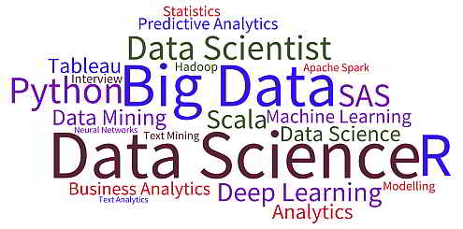
A quick introduction to data science
Data science has been recently trending, with many keyswords…
But what is the core idea behind this data science concept?

Slide 8
A quick introduction to data science
Data science has been recently trending, with many keyswords…
But what is the core idea behind this data science concept?
Core ideas
make sense from data
and learn information from it.

Slide 9
Core idea behind data science: find the missing function, based on available data
What we have done in Programming so far was to design functions,
which would do specific operations
and return outputs
for any input we could give it
Input (given)
Function
(Created)
Output
(Obtained)

Slide 10
Core idea behind data science: find the missing function, based on available data
What we have done in Programming so far was to design functions,
which would do specific operations
and return outputs
for any input we could give it
But sometimes, we can encounter problems where
we can easily find inputs and expected outputs,
but the function to be coded is not simple to figure out.
Input (given)
Function
(Created)
Output
(Obtained)
Input (available)
Function
(?)
Output
(available)

Slide 11
Core idea behind data science: find the missing function, based on available data
What we have done in Programming so far was to design functions,
which would do specific operations
and return outputs
for any input we could give it
But sometimes, we can encounter problems where
we can easily find inputs and expected outputs,
but the function to be coded is not simple to figure out.
Idea: What if the computer could learn the function on its own?
Input (given)
Function
(Created)
Output
(Obtained)
Input (available)
Function
(?)
Output
(available)

Slide 12
A typical example
For instance, if I were to give you this table of values…
Inputs x | Outputs y
1 | 1
2 | 4
3 | 9
4 | 16
5 | 25
7 | 49
8 | 64
9 | 81
10 | 100

Slide 13
A typical example
For instance, if I were to give you this table of values…
And then ask you to guess the expected output for the value 6…
Inputs x | Outputs y
1 | 1
2 | 4
3 | 9
4 | 16
5 | 25
6 | ?
7 | 49
8 | 64
9 | 81
10 | 100

Slide 14
A typical example
Inputs x | Outputs y
1 | 1
2 | 4
3 | 9
4 | 16
5 | 25
6 | ?
7 | 49
8 | 64
9 | 81
10 | 100
For instance, if I were to give you this table of values…
And then ask you to guess the expected output for the value 6…
You would probably guess, it is 36.

Slide 15
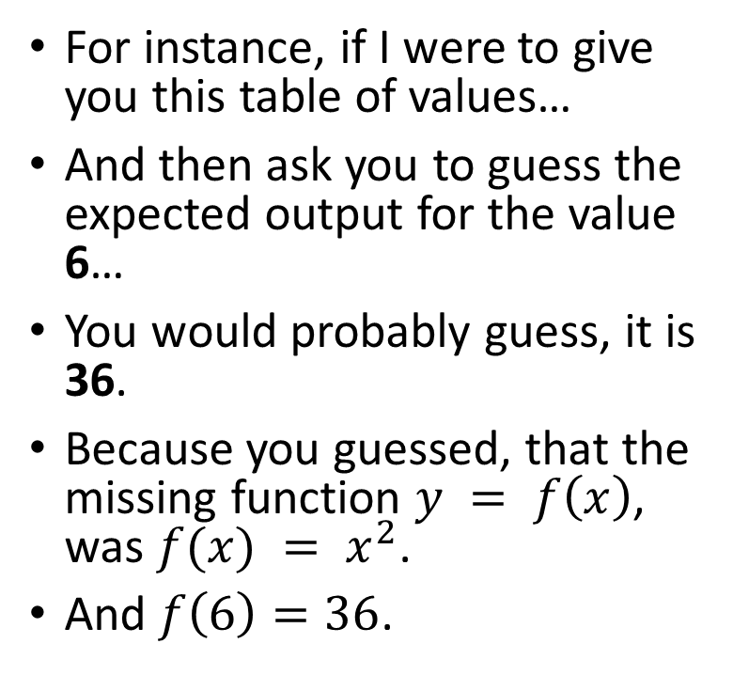
A typical example
Inputs x | Outputs y
1 | 1
2 | 4
3 | 9
4 | 16
5 | 25
6 | ?
7 | 49
8 | 64
9 | 81
10 | 100
For instance, if I were to give you this table of values…
And then ask you to guess the expected output for the value 6…
You would probably guess, it is 36.
Because you guessed, that the missing function $y = f\left(x\right)$, was $f(x) = x^{2}$.
And $f\left(6\right)=36$.

Slide 16
Record/Experience, features/inputs and labels/outputs
Inputs x | Outputs y
1 | 1
2 | 4
3 | 9
4 | 16
5 | 25
7 | 49
8 | 64
9 | 81
10 | 100
6 | ?
What just happened?

Slide 17
Record/Experience, features/inputs and labels/outputs
Inputs x | Outputs y
1 | 1
2 | 4
3 | 9
4 | 16
5 | 25
7 | 49
8 | 64
9 | 81
10 | 100
6 | ?
What just happened?
You used your previous experience/record
Experience/Record

Slide 18
Record/Experience, features/inputs and labels/outputs
Inputs x | Outputs y
1 | 1
2 | 4
3 | 9
4 | 16
5 | 25
7 | 49
8 | 64
9 | 81
10 | 100
6 | ?
What just happened?
You used your previous experience/record
To “guess” what might be the relationship/function f
Between your inputs/features x
And their respective outputs/labels y
Experience/Record
Input x (available)
Function f
(?)
Output y = f(x)
(available)

Slide 19
About regression
That is a very common problem in data science, called regression.

Slide 20
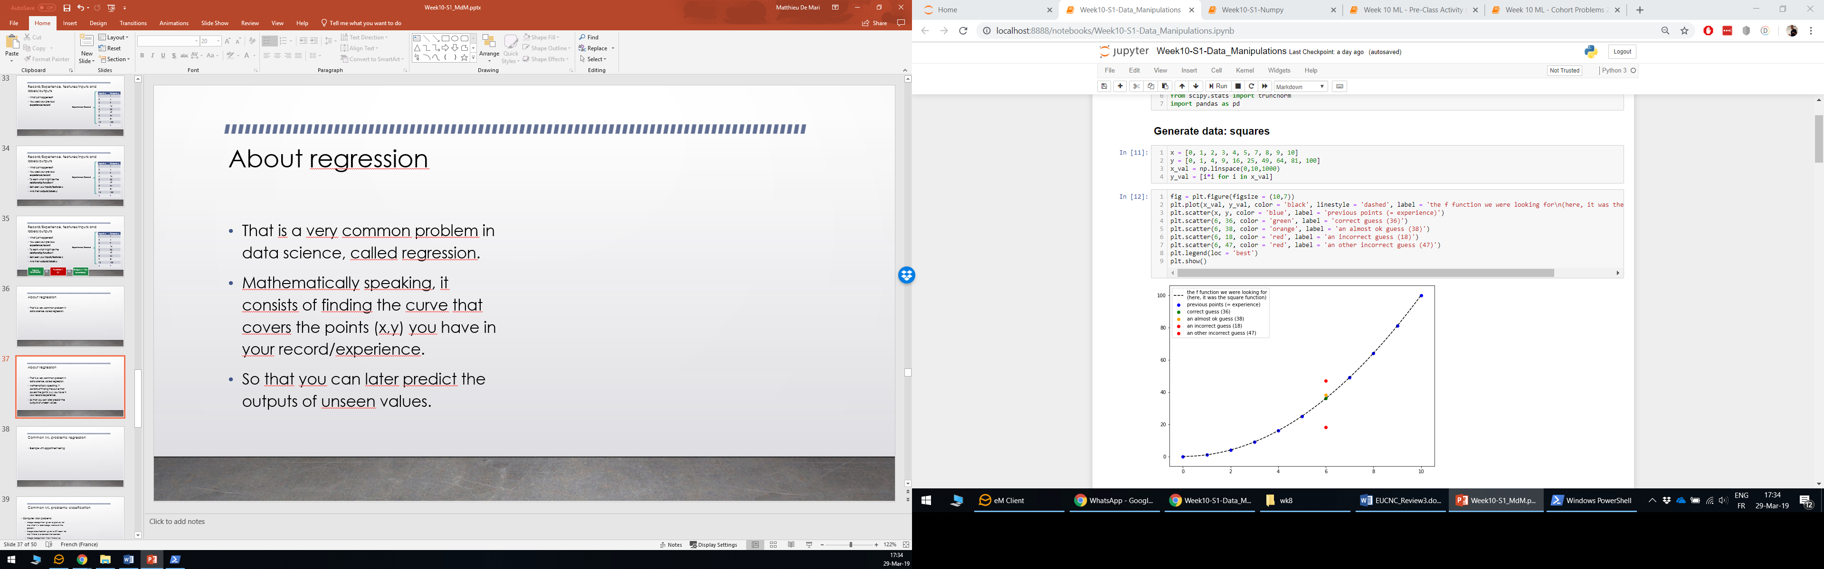
About regression
That is a very common problem in data science, called regression.
Mathematically speaking, it consists of finding the curve that covers the points (x,y) you have in your record/experience.
So that you could later predict the outputs of unseen input values.

Slide 21
Typical problems in regression
Inputs x | Outputs y
1 | 1
2 | 4
3 | 9
4 | 16
5 | 25
7 | 49
8 | 64
9 | 81
10 | 100
6 | ?
Typically, our squares example

Slide 22
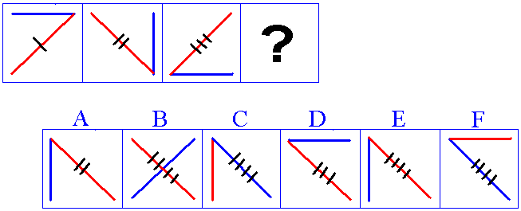
Typical problems in regression
Inputs x | Outputs y
1 | 1
2 | 4
3 | 9
4 | 16
5 | 25
7 | 49
8 | 64
9 | 81
10 | 100
6 | ?
Typically, our squares example
The IQ tests: « guess the element that comes next in the sequence »

Slide 23
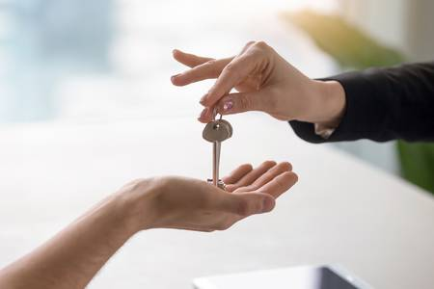
Typical problems in regression
Inputs x | Outputs y
1 | 1
2 | 4
3 | 9
4 | 16
5 | 25
7 | 49
8 | 64
9 | 81
10 | 100
6 | ?
Typically, our squares example
The IQ tests: « guess the element that comes next in the sequence »
Exemple with appartment selling
Guessing the selling price of an appartment based on its size and your previous sales.

Slide 24
Typical problems in regression
Inputs x | Outputs y
1 | 1
2 | 4
3 | 9
4 | 16
5 | 25
7 | 49
8 | 64
9 | 81
10 | 100
6 | ?
Typically, our squares example
The IQ tests: « guess the element that comes next in the sequence »
Exemple with appartment selling
Guessing the selling price of an appartment based on its size and your previous sales.
Etc.

Slide 25
Regression and classification
Regression problems are very common in real-life.
Other very common problems are classification ones.
Input x (available)
Function f
(?)
Output y = f(x)
(available)

Slide 26

Regression and classification
Regression problems are very common in real-life.
Other very common problems are classification ones.
Typically used in computer vision.
Input x (available)
Function f
(?)
Output y = f(x)
(available)
Very easy for a human…
It’s a cat!

Slide 27
Regression and classification
Regression problems are very common in real-life.
Other very common problems are classification ones.
Typically used in computer vision.
Input x (available)
Function f
(?)
Output y = f(x)
(available)
Very easy for a human…
How would we do it with a computer?
It’s a cat!

Slide 28
Classification are very common in computer vision
Computer vision problems:
Image recognition: given a picture, tell me what it is (cats/dogs, name of the person)
It’s a cat!

Slide 29
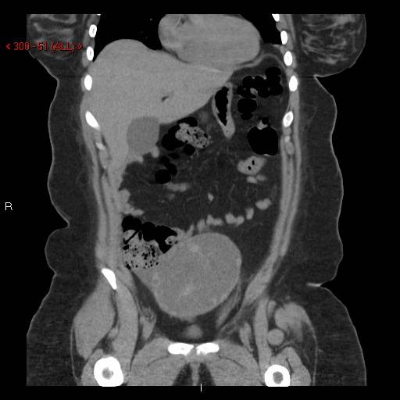
Classification are very common in computer vision
Computer vision problems:
Image recognition: given a picture, tell me what it is (cats/dogs, name of the person)
Image classification: given a CT scan, tell me if there is a cancer/not cancer
That’s
cancerous

Slide 30
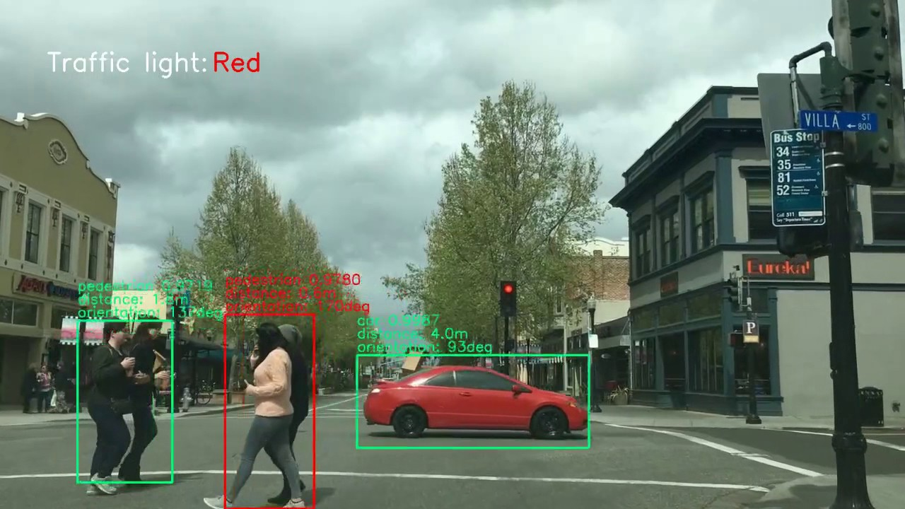
Classification are very common in computer vision
Computer vision problems:
Image recognition: given a picture, tell me what it is (cats/dogs, name of the person)
Image classification: given a CT scan, tell me if there is a cancer/no cancer
Image recognition + segmentation:
find if there is a pedestrian in the picture
and if so, where he/she is,
And what its movement is.

Slide 31
Recap for data science
Machine learning foundations (mathematical and computational)
Advanced machine learning and AI
Convolutional neural networks for image processing.
Recurrent neural networks and Natural Language Processing
Generative Adversarial Networks (technology behind deepfakes).
Image processing and computer vision
Robotics
Reinforcement learning (technology behind Alpha Go Zero)

